Slide 1
Run PowerShell with Azure deployment scripts
Leo Visser

Slide 2
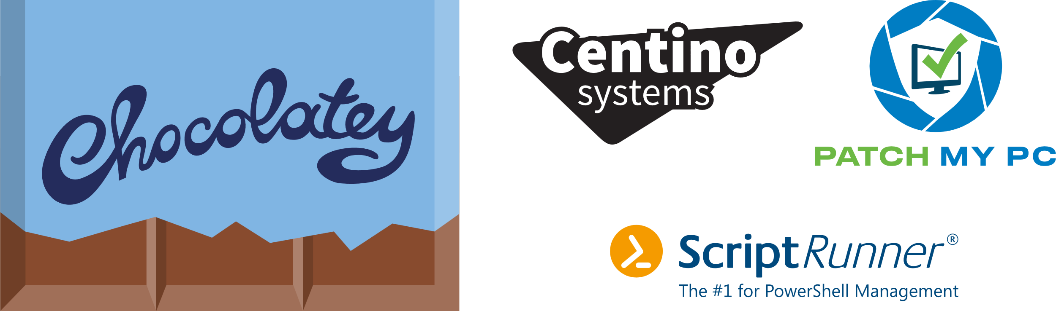
Many thanks to our sponsors:

Slide 3
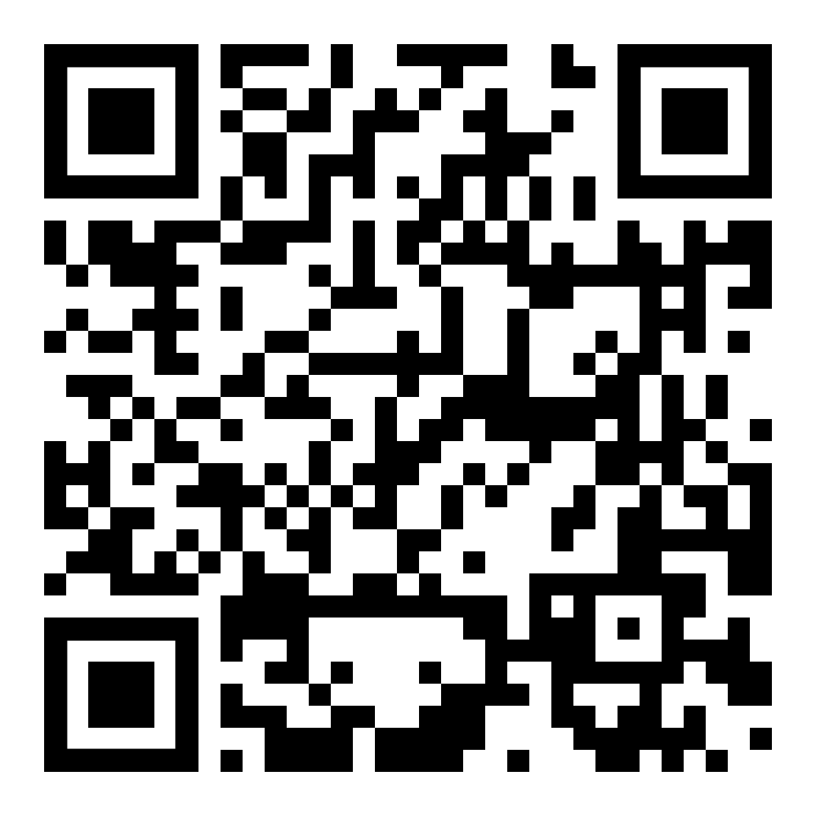
Community Demos
Notes:
1 (2)

Slide 4

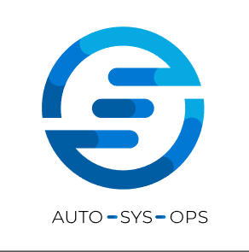
Leo Visser
Cloud Consultant @ OGD-ict diensten
IAC, CI/CD, Automation, Agile, DevOps
Twitter: @autosysops
Blog: www.autosysops.com
Notes:
1 (1)

Slide 5
Agenda
What are deployment scripts
When to use deployment scripts
Authentication
Input and output
Troubleshooting
How I used them
Notes:
1 (2)

Slide 6

What are deployment scripts
Deployment
Resource
Resource
Notes:
1 (3)

Slide 7
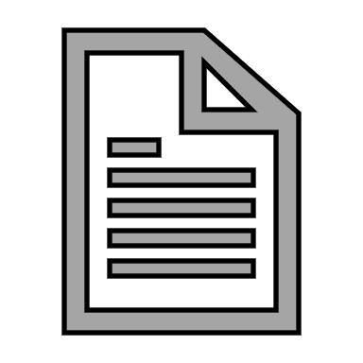
What are deployment scripts
Deployment
Resource
Resource
Script
Resource
Notes:
2 (5)

Slide 8
Notes:
2 (7)

Slide 9
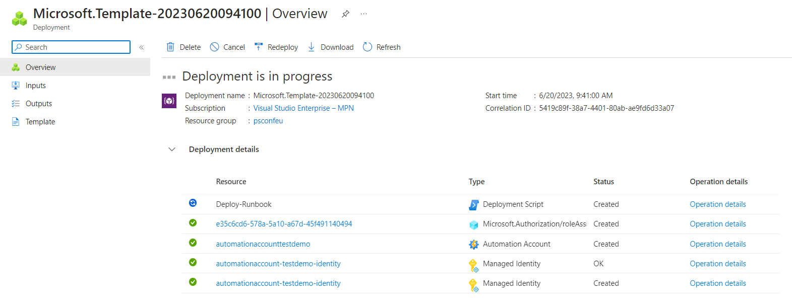

Slide 10
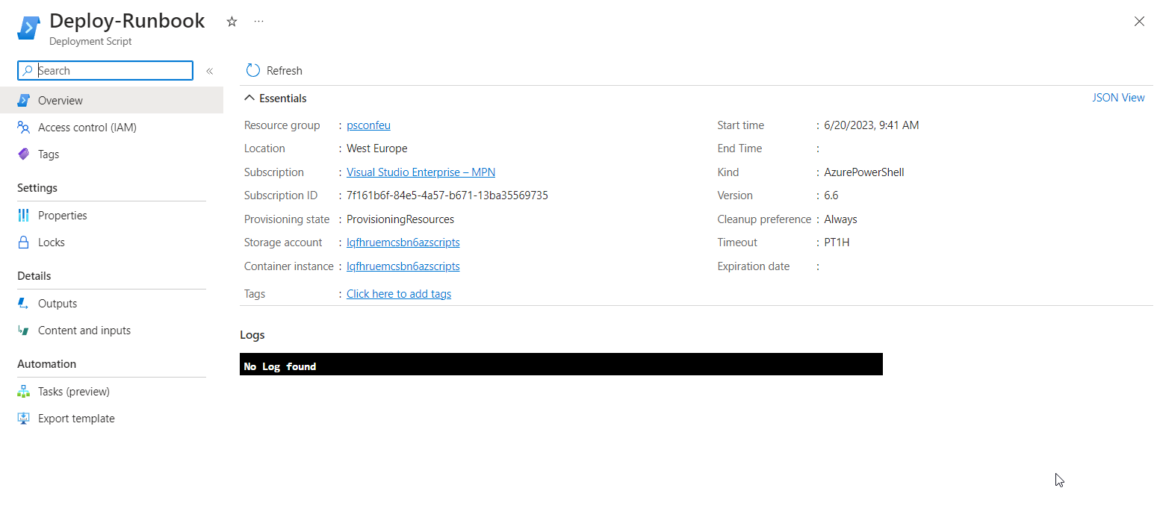

Slide 11
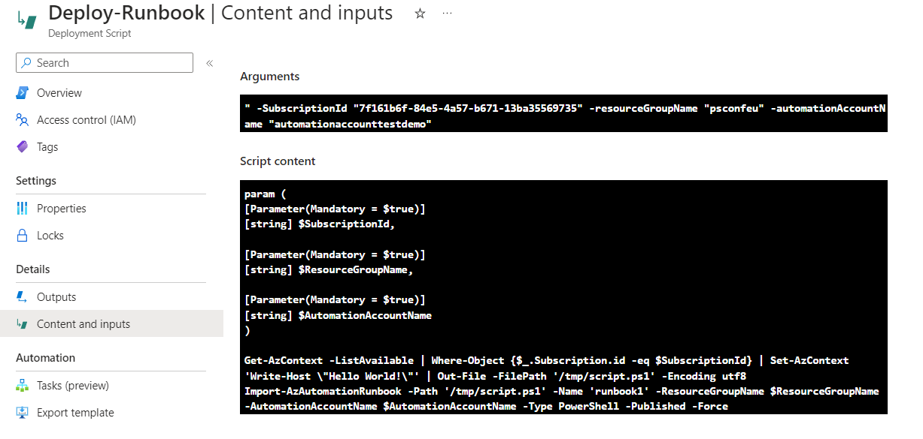

Slide 12
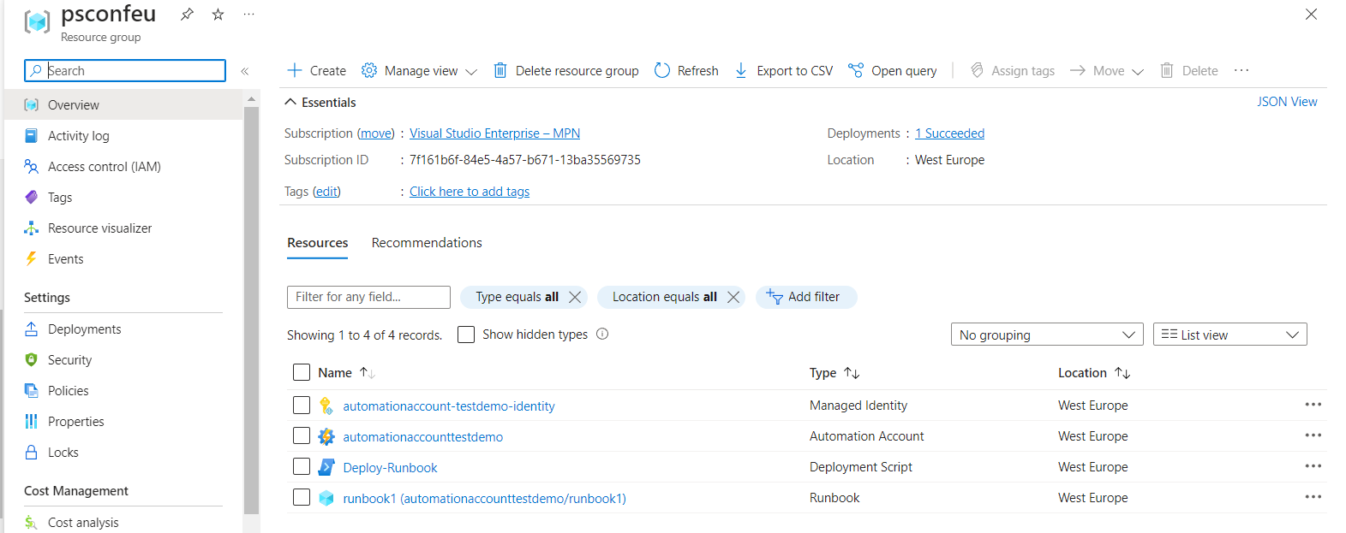

Slide 13
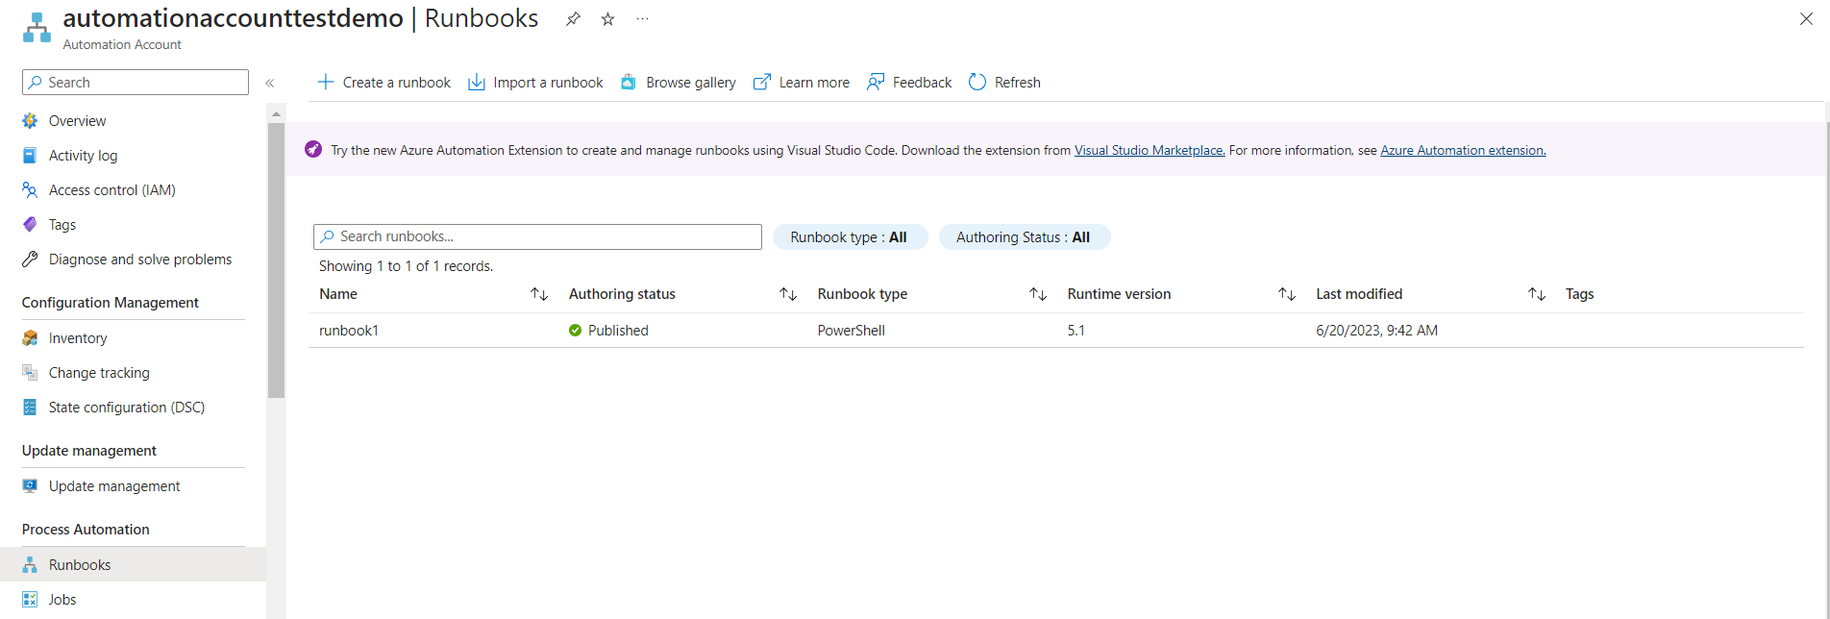

Slide 14
When to use deployment scripts
Needs to be one deployment template
Examples:
Adding delay
Calculating values
Running additional tasks
Notes:
3 (10)

Slide 15
When to use deployment scripts
ARM and BICEP supported
Advantages:
Automatic cleanup
Identity options
Scripts in remote locations
AzPowerShell included
Notes:
2 (12)

Slide 16
Notes:
Go back to demo 1 2 (14)

Slide 17
Authentication
Managed Identities
User assigned
Create permissions beforehand
Notes:
1 (15)

Slide 18
Notes:
Go back to demo 1 2 (17)

Slide 19
Input and output
Input:
Defined as arguments in template
Multiple inputs supported
Output:
Defined as $DeploymentScriptOutputs object
Multiple outputs supported
Notes:
2 (19)

Slide 20
Notes:
4 (23)

Slide 21
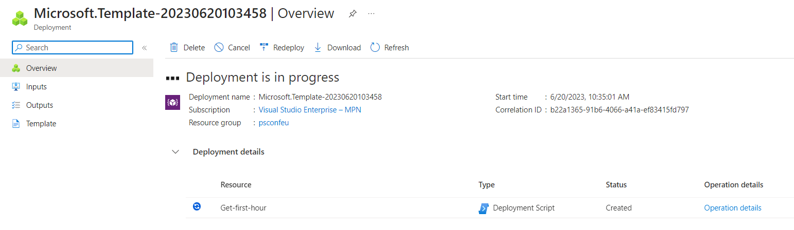

Slide 22
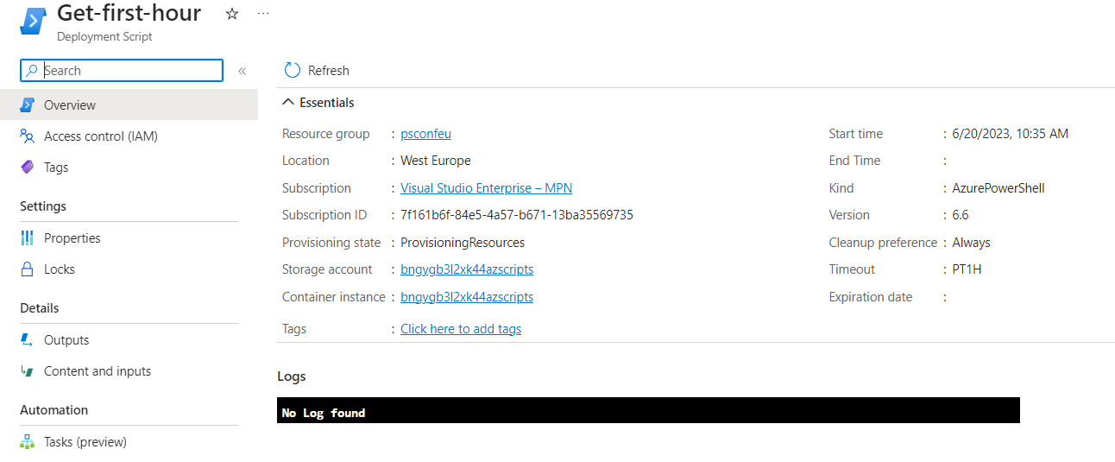

Slide 23
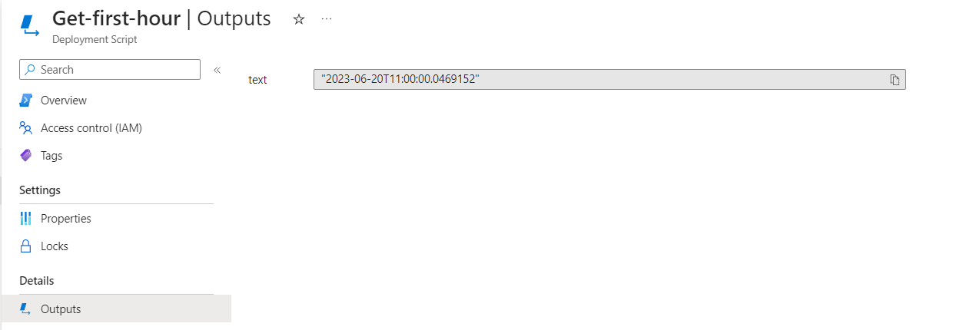

Slide 24
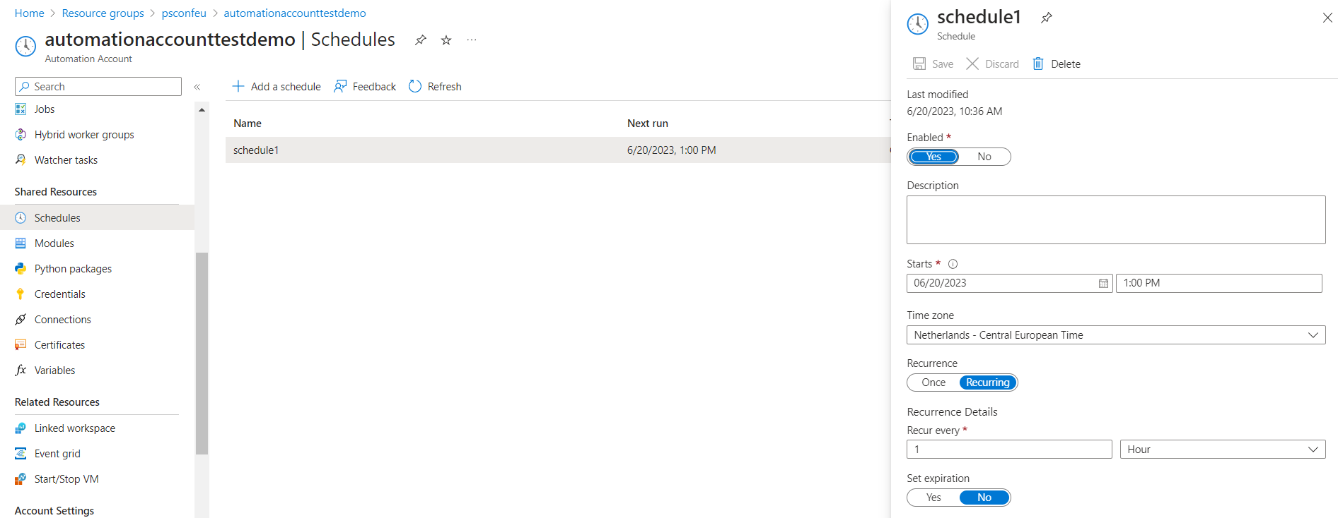

Slide 25
Troubleshooting
Scripts can fail
Error logging
Notes:
2 (25)

Slide 26
Notes:
3 (28)

Slide 27
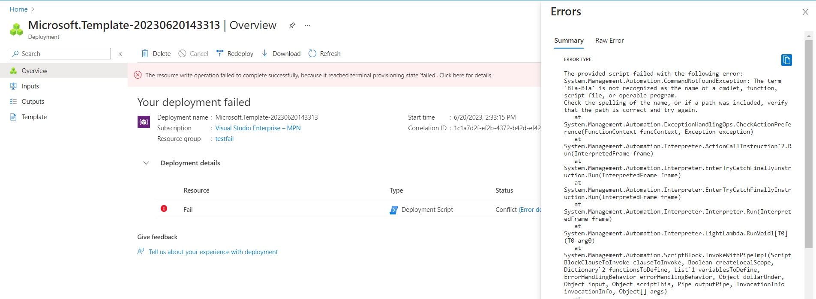

Slide 28
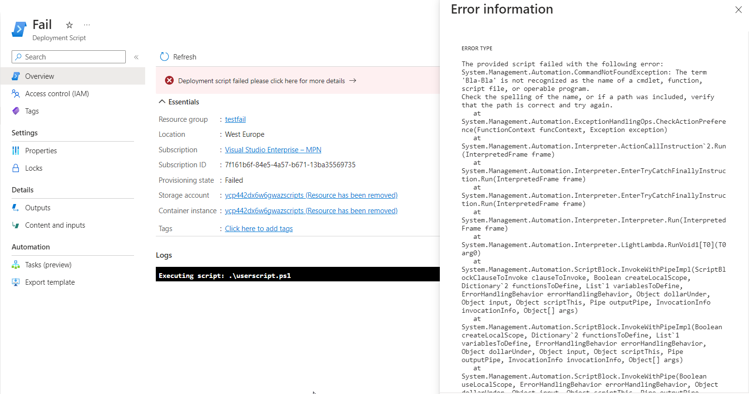

Slide 29
How I used them
Policy remediation scripts for complex tagging requirements
Automatically deploy a start/stop vm solution with custom scripts for update management
Notes:
2 (30)

Slide 30
Q&A
15 minutes

